Slide 1

Developing with the Brightcove Player
Matt Boles
mboles@brightcove.com

Slide 2
How: Agenda
Introducing the Course
Setting Up to Develop with Brightcove Player
Demo: Programmatically Play a Video
Using JavaScript with Brightcove Player
Getting Started with Brightcove Player Development
Task 1: Using the API to Play a Video
Using the Player Catalog
Task 2: Dynamically Loading and Playing a Video
Using the mediainfo Property
Task 3: Displaying Video Information in the HTML Page
Using the Standard (iframe) Player Implementation
Task 4: Changing the Video in an iframe Player Implementation
Adding a Brightcove Plugin to a Player
Task 5: Display an Overlay that Uses mediainfo Data

Slide 3
Introducing the Course

Slide 4
What: Brightcove Player
The Brightcove Player is based on the Video.js Player
Three core elements:
Video embed code - Places a video into a website using the HTML5 <video> element
JavaScript library - Makes the player work across browsers, their various versions and around device / platform bugs
Pure HTML/CSS skin - Creates a uniform look across HTML5 browsers and easy custom skinning for a branded look

Slide 5
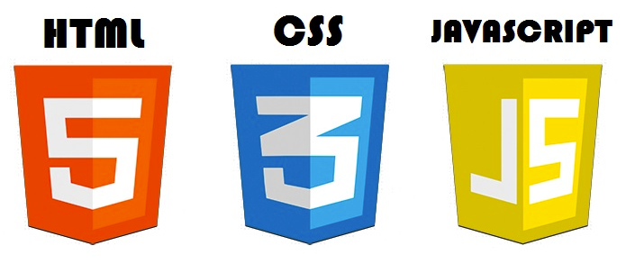
What: Brightcove Player Development
Used to customize, integrate with, or add functionality to, your players
Uses HTML5, CSS, JavaScript and the Player API
Cross-platform standards
Developer-friendly technologies

Slide 6
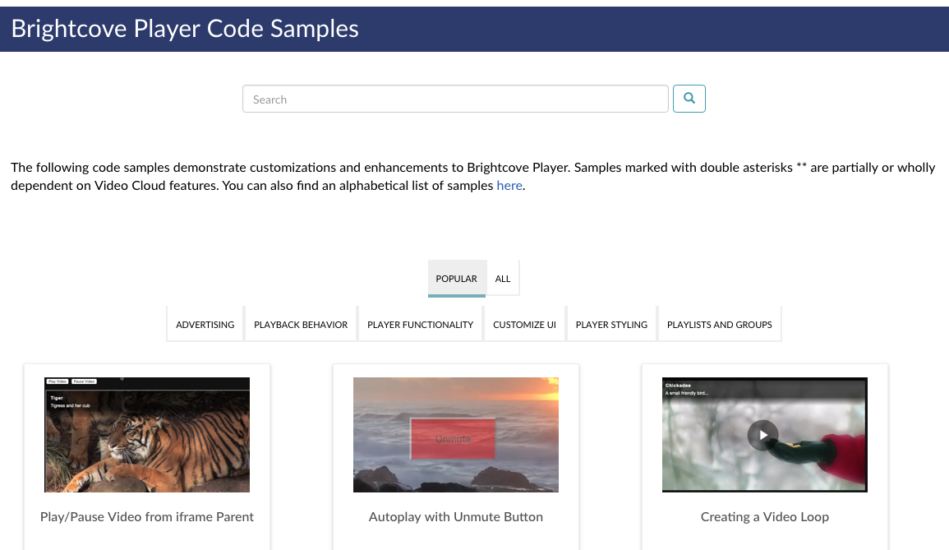
Why: Code Samples

Slide 7
Prerequisites
The session is designed for developers with basic HTML and JavaScript experience

Slide 8
Setting Up to Develop with Brightcove Player

Slide 9
Setup
Video Cloud Account
You will also need an editor for HTML/JavaScript
Any plain text editor will work
An editor such as Atom, Chocolat, Sublime Text, Dreamweaver, BBEdit, or CoffeeCup, that provides code-hinting and syntax highlighting is recommended
For iframe player implementation examples a web server is needed
XAMPP and WAMP free options

Slide 10
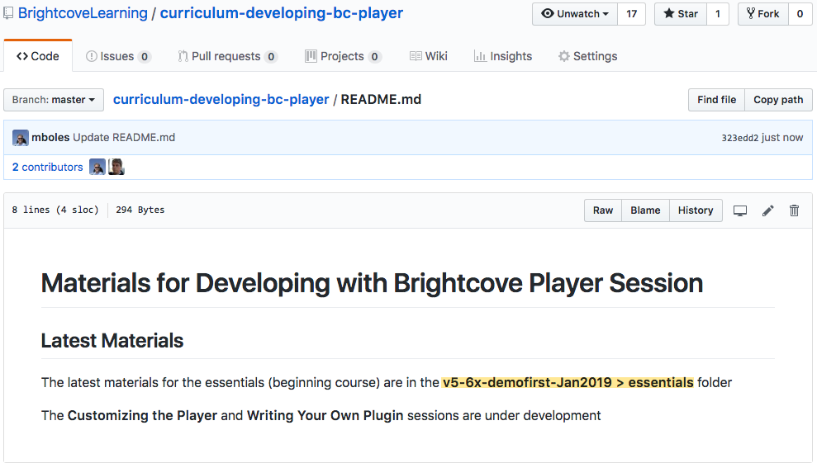
Getting Session Materials - GitHub
Student files and slides
https://github.com/BrightcoveLearning/curriculum-developing-bc-player
http://bit.ly/1EDWaCA

Slide 11
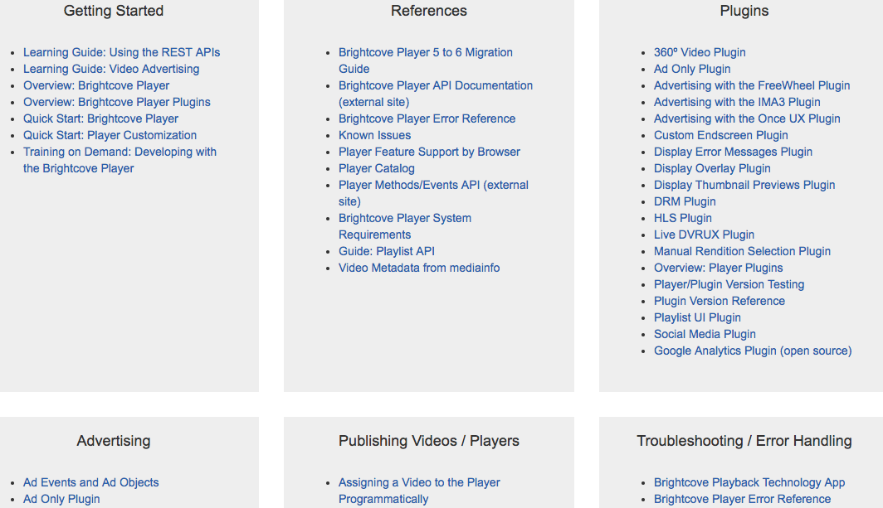
Brightcove Player Documentation
https://support.brightcove.com/brightcove-player-developer

Slide 12
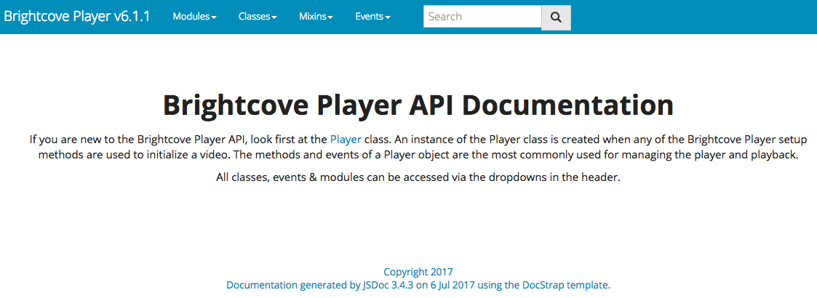
Brightcove Player API Documentation
https://brightcovelearning.github.io/Brightcove-API-References/brightcove-player/current-release/index.html

Slide 13
Demo: Programmatically Play a Video
Quick look at the process of using the API
(a “Spiral Learning” event)

Slide 14
Using JavaScript with Brightcove Player

Slide 15
API Is Event Driven
Event driven framework: Behaviors driven by the production, detection and consumption of events
videojs.getPlayer('myPlayerID') .ready(function(){
var myPlayer = this;
});
otherComponent.on("play", function(){
//Video is playing
});
function foo() {
player = this;
player.loadVideo(123);
player.play();
}

Slide 16
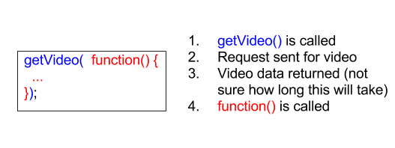
Callback Functions
A function passed to another function to be called at a later time
Example: getVideo() called, then the callback function called when video data returned, which is a variable amount of time

Slide 17
Callback Function Implementations
Anonymous functions: The function definition is the argument of the function
Function not named, hence anonymous
Called immediately after getVideo function has done its job
getVideo( function(){ … })
Function declaration (“normal way”)
Loads before any code is executed, then called from different location
function foo() { … }
Function expression
Loads only when the interpreter reaches that line of code, then called from a different location
var foo = function() { … }

Slide 18
Conceptual Blockbusters!!
Brightcove Player API is event driven
Callback function’s argument (function in parentheses) is not called until the callback function’s job is finished

Slide 19
Getting Started with Brightcove Player Development
Use Case: Play the video programmatically

Slide 20
Get Reference to Player
Create a <script> block
Use the ready method
Create variable that holds reference to the player instance
videojs.getPlayer('myPlayerID').ready(function(){
var myPlayer = this;
});

Slide 21
Get Reference to Player - cont
Note that using ready() functions correctly if you wish to interact with the player, for instance programmatically to change player behavior
If you wish to immediately interact with the video, for instance use play(), another approach must be used
Detailed in the coming Events section

Slide 22
Player Methods
Docs: //brightcovelearning.github.io/Brightcove-API-References/brightcove-player/current-release/Player.html#toc6__anchor
Method example
myPlayer.play();
myPlayer.muted(true);

Slide 23
Player Events
Docs: //brightcovelearning.github.io/Brightcove-API-References/brightcove-player/current-release/Player.html#toc120__anchor
Use on(), one() and off() methods to add and remove event listeners
Event example
myPlayer.on("timeupdate", showUpdate);

Slide 24
Player Events - cont
If you wish to immediately interact with the video, for instance use play(), you should use the loadedmetadata event to be sure the VIDEO is loaded in the PLAYER
videojs.getPlayer('myPlayerID').ready(function(){
var myPlayer = this;
myPlayer.muted(true);
myPlayer.on('loadedmetadata', function(){
myPlayer.play();
});
});

Slide 25
Considerations for autoplay
Using the muted() getter/setter method to avoid the issue in this session
Document available with details
Autoplay Considerations
https://support.brightcove.com/autoplay-considerations
Sample “solution”
Brightcove Player Sample: Autoplay with Unmute Button for iOS/Safari/Chrome
https://support.brightcove.com/brightcove-player-sample-autoplay-unmute-button-iossafarichrome

Slide 26
Conceptual Blockbuster!!
When playing a video in the Video Cloud environment, TWO entities are involved
Player
Video

Slide 27
Task 1: Using the API to Play a Video and Display Event Object

Slide 28
Using the Player Catalog
Use Case: Change the video on user interaction

Slide 29
Player Catalog
Player Catalog is a helper library for making requests to the Video Cloud catalog
The catalog makes it easy to get information on Video Cloud media/playlists and use
Numerous methods available, but in this session will focus on
myPlayer.catalog.getVideo(videoID,callback)
myPlayer.catalog.getPlaylist(playlistID,callback)
myPlayer.catalog.load(videoObject)

Slide 30
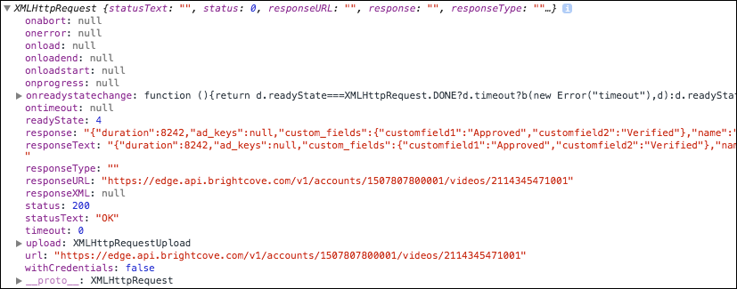
Returned Object from getVideo()
Catalog returns an object of type XMLHttpRequest

Slide 31
Task 2: Dynamically Loading and Playing a Video

Slide 32
Using the mediainfo Property
Use Case: Display information about the video on the HTML page

Slide 33
mediainfo Property
The mediainfo property is an object which contains information on the current media in the player
The property is created and populated after the loadstart event is dispatched
After the mediainfo object is populated, use it for convenient data retrieval when wishing to display video information, like the video name or description

Slide 34
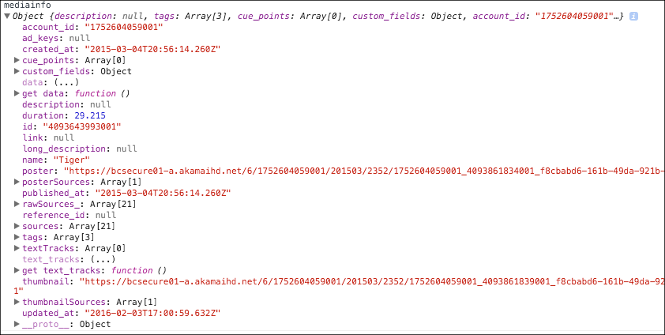
Data in mediainfo

Slide 35
Access mediainfo Data
Access the data in the mediainfo object by simple object.property notation
dynamicHTML = "<p>Video Title: <strong>" + myPlayer.mediainfo.name + "</strong></p>";
dynamicHTML += "<p>Description: <strong>" + myPlayer.mediainfo.description + "</strong></p>";
document.getElementById("textTarget").innerHTML = dynamicHTML;

Slide 36
Conceptual Blockbuster!!
You cannot access the mediainfo object until the loadstart event is dispatched

Slide 37
Task 3: Display Video Information in the HTML Page
**Uses the ready() event/method
CodePen: http://codepen.io/team/bcls/pen/KzyoNG

Slide 38
Using the Standard (iframe) Player Implementation
Use Case: Utilize the iframe implementation of the player and change the video on user interaction

Slide 39
Advantages of Standard (iframe) Player Implementation
No collisions with existing JavaScript and/or CSS
Automatically responsive (nearly)
The iframe eases use in social media apps (or whenever the video will need to "travel" into other apps)

Slide 40
When You Cannot Use iframe Implementation
Code in the containing page needs to listen for and act on player events
The player uses styles from the containing page
The iframe will cause app logic to fail, like a redirect from the containing page

Slide 41
Dynamically Change Video in iframe
To dynamically change video in an iframe change the query string’s the src property
<iframe src='//players.brightcove.net/921483702001/a5f0f07c-ce3b-48a4-af02-f5f6c38546ac_default/index.html ?videoId=4341341161001' …></iframe>
Need to remove the existing query string then add a new one

Slide 42
Dynamically Change Video in iframe (cont)
Plan of action
Get a handle on the <iframe> tag
Create a variable with the new query string (new video ID)
Assign the src property of the <iframe> to a variable
Remove the existing query string from the source
Add the new query string to the source
Assign the new source to the <iframe>

Slide 43
Dynamically Change Video in iframe (cont)
<function changeVideo() {
var iframeTag = document.getElementsByTagName("iframe")[0],
newVideo = "?videoId=3742256815001",
theSrc = iframeTag.src,
srcWithoutVideo = theSrc.substring( 0, theSrc.indexOf( "?" ) ),
newSrc = srcWithoutVideo + newVideo;
iframeTag.src = newSrc;
}
JavaScript’s theString.substring() extracts characters from the first parameter to the second

Slide 44
Communicate Between HTML Page and iframe
It is possible to communicate between the parent page and the iframe
Uses HTML postMessage
Example doc: Play Video from iframe Parent
//docs.brightcove.com/en/player/brightcove-player/samples/listen-for-play-button.html
Example doc: Implementing Playlists Programmatically: Passing video ID on URL page request for iframe
//support.brightcove.com/implementing-playlists-programmatically#Set_initial_video

Slide 45
Task 4: Changing the Video in an iframe Player Implementation
CodePen: http://codepen.io/team/bcls/pen/WwXVNm

Slide 46
Adding a Brightcove Plugin to a Player
Use Case: Display an overlay that uses data from the mediainfo object

Slide 47
Plugins for Brightcove Player
A plugin for the Brightcove player uses a combination of HTML, JavaScript and/or CSS to somehow customize the player
In other words, anything you can do in a web page, you can do in a plugin
Broadly, plugins can be developed to
Modify default behavior
Add functionality
Customize appearance

Slide 48
Brightcove Supplied Plugins
360 Video
Ad Only
Advertising with FreeWheel
Advertising with IMA3
Advertising with SSAI
Chromecast
Custom Endscreens
Display Errors
Display Overlay
DRM
HLS
Live DVRUX
Picture-in-Picture
Playlist UI
Quality Selection
Social Media

Slide 49
Brightcove Plugins Loaded by Default
The following are plugins loaded by default
Errors
HLS

Slide 50
Implementing Plugins Using Studio UI
One of three ways to use a plugin
Use the Studio UI to supply the plugin's
JavaScript
Name
Options (if needed)
CSS (if needed)
Plugin associated with ALL instances of the player

Slide 51
Implementing Plugins Using Custom Code
Second way use a plugin
Use a <script> tag to manually include the plugin's JavaScript
Use a <link> tag to manually include the plugin's CSS (if needed)
Call the plugin as a method, supplying required options
myPlayer.overlay({
…
});
Plugin associated ONLY with the instance of the player on the page
Provides flexibility, such as dynamically supplying options

Slide 52
Implementing Plugins Using curl Statements
Can configure the player, and associated plugins, using the Player Management API
Details on using curl not part of this course
curl --header "Content-Type: application/json" --user $EMAIL --request PATCH \
--data '{
"stylesheets": ["http://…/plugin-dev.css"
],
"scripts": ["http://…/plugin-dev.js"
],
"plugins": [{ "name": "pluginDev", "options": {"overlayText": "This …"}
}]
}' \
https://players.api.brightcove.com/v1/accounts/$ACCOUNT_ID/players /$PLAYER_ID/configuration

Slide 53
Task 5: Display an Overlay that Uses mediainfo Data
Task 5 CodePen: http://codepen.io/team/bcls/pen/PNEWQJ

Slide 54
Tools More Developers Should Know About
Video.js Middleware
Brightcove Player Sample: Disable Forward Scrubbing
https://support.brightcove.com/brightcove-player-sample-disable-forward-scrubbing
Brightcove Player Sample: Playback Rate Adjuster
https://support.brightcove.com/brightcove-player-sample-playback-rate-adjuster
Catalog’s search methods
Player Catalog
https://support.brightcove.com/player-catalog#getSearch_method

Slide 55
Thank You!
Matt Boles
mboles@brightcove.com

